Slide 1
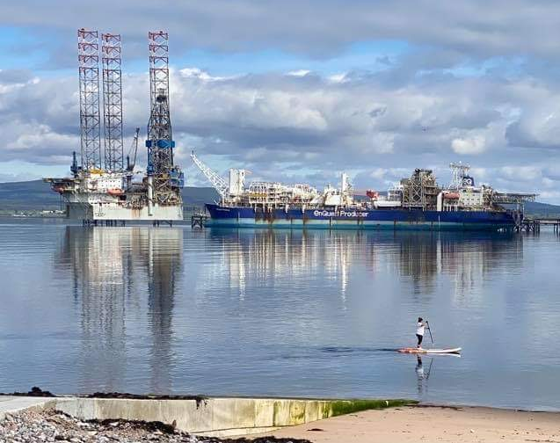
Report for Community Council
Our own Queen of the Firth
19th April 2021 – 21st May 2021
By Fraser Thomson
Assistant Youth Worker.

Slide 2
What we have been up to?
Face to Face Junior Youth Café
Face to Face Senior Youth Café
Multi-Sports
Rowing
Various Recognised Achievements Awards
In-service Day Activities
1-1’s

Slide 3
Number
Total Number of Young People Worked with: 264
Total Number of Sessions Delivered: 42
Total Number of Learning Hours: 315

Slide 4
Outdoor Junior Youth Café
It is great to be back outdoor and thankfully the weather has held out and stayed dry.
All of the young people who attend are loving being back at youth café.
We do lots of fun activities, such as whacky races, Swim Fish Swim, Football, Dodgeball, Basketball, and lots of other activities
Each week we ensure that we are sticking to all the government guidelines.

Slide 5
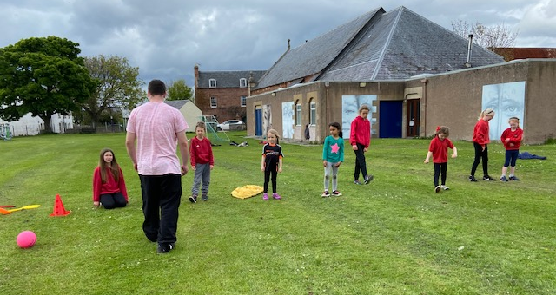
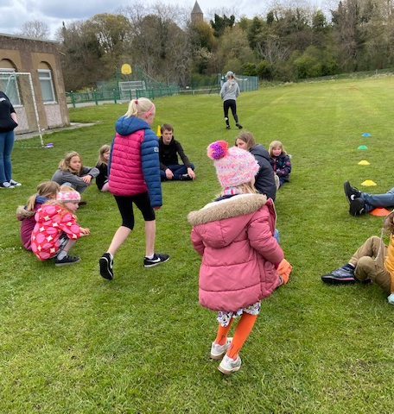
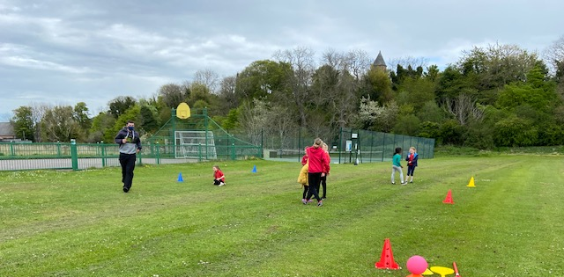

Slide 6
Outdoor Senior Youth Café
All of the young people that attend senior Youth Café are enjoying being back outdoor and seeing us face to face.
Each week we play lots of games that the young people want to play.
One of the session’s was from Ian McZappa with the Cromarty Cycling with out age trikes – all the young people loved this session.
Some weeks the young people decide on the games and deliver the part of the session.

Slide 7
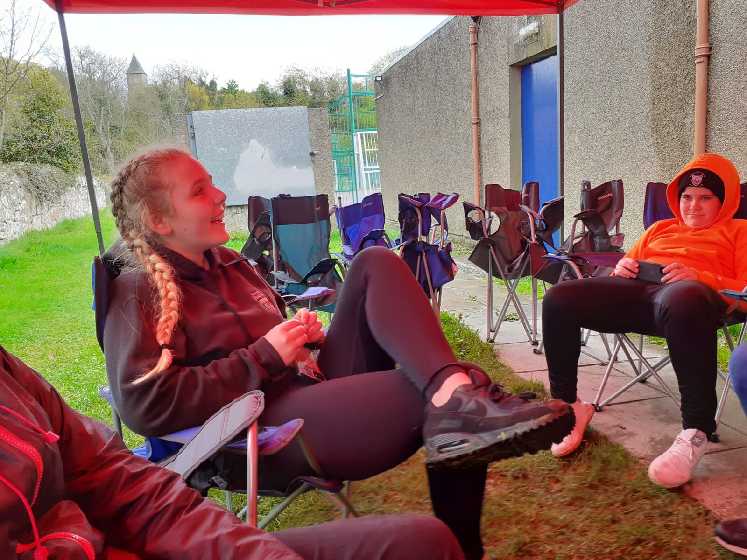
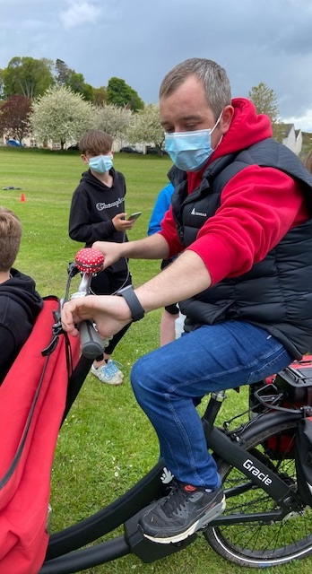
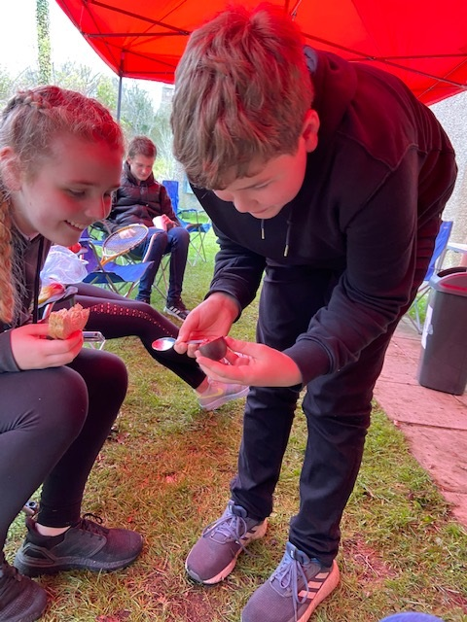
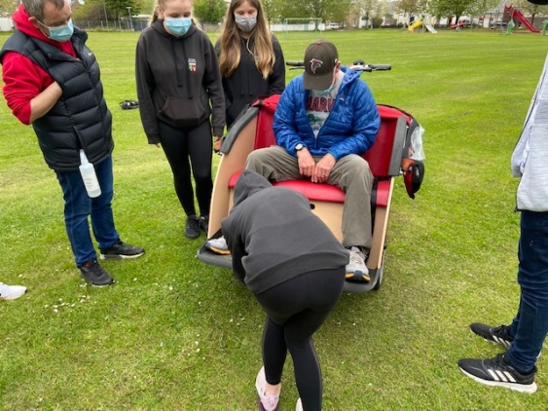

Slide 8
Multi-Sports
Multi Sports runs on a Wednesday night
The class is ran by 3 young leaders
Each week the young leaders plan and deliver their sessions
There is range of sports taking place:
Football
Dodgeball
Hockey
Basketball
Omnikin Balls
Fun Games

Slide 9
Who are the Multi-Sports Leaders L to R Loreta, Orlagh & Hayden

Slide 10
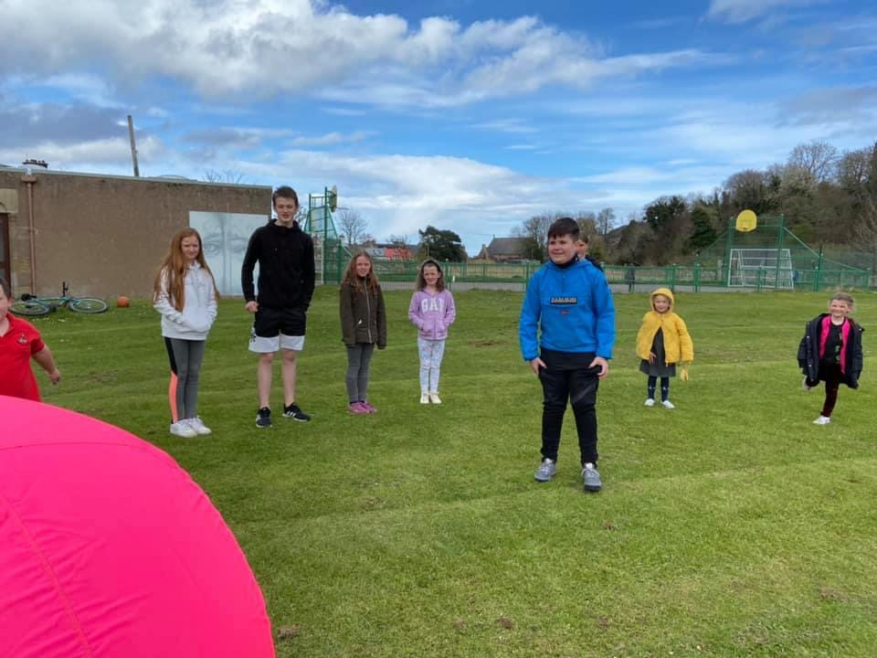
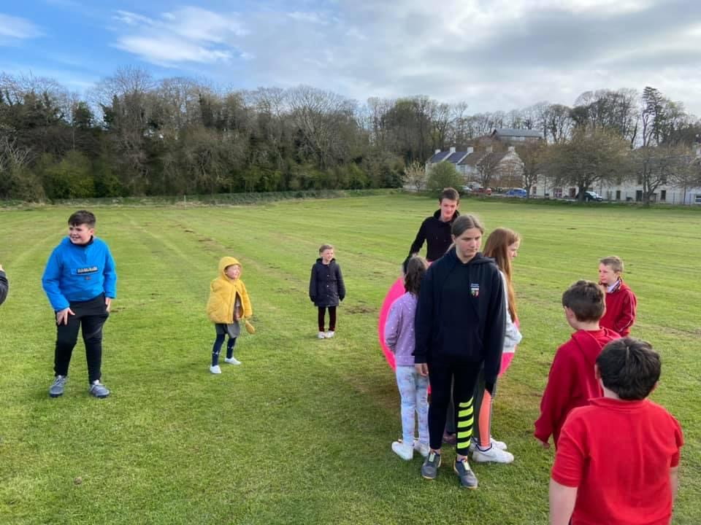

Slide 11
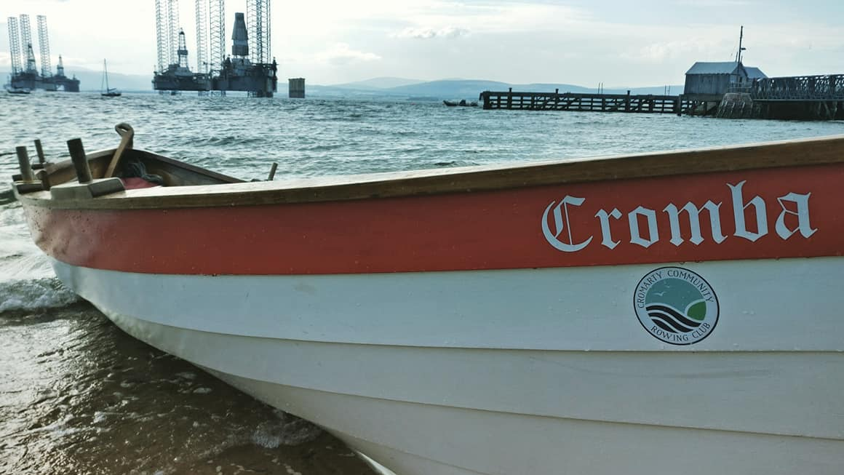
Rowing
Each week there is 5 hours of Youth rowing
Sessions are on a Monday & Friday
This year there is lots of new young people who are taking part in the rowing and are loving being on the water.
With the range of different cox’s the young people’s timing and skills are improving
CCRC have 2 young people on their committee, and these young people coordinate all the rows with the support of Wanda,
Wanda is in the process of the putting another 9 adults through PVG’s with Disclosure Scotland

Slide 12
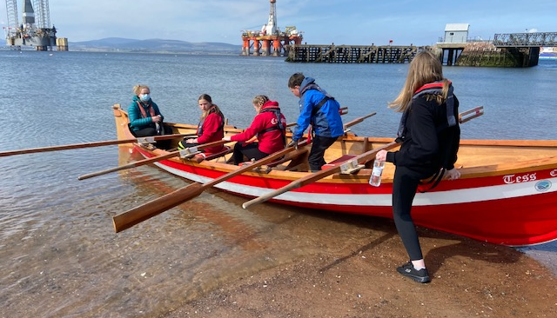
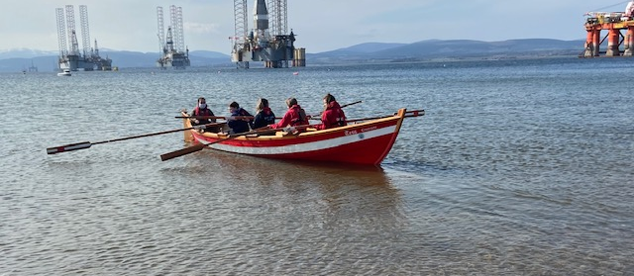
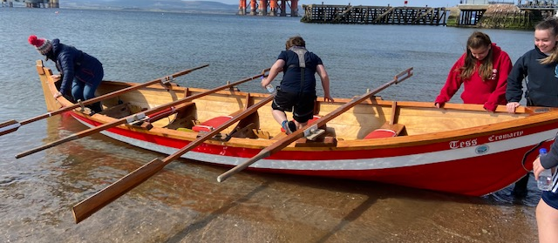

Slide 13
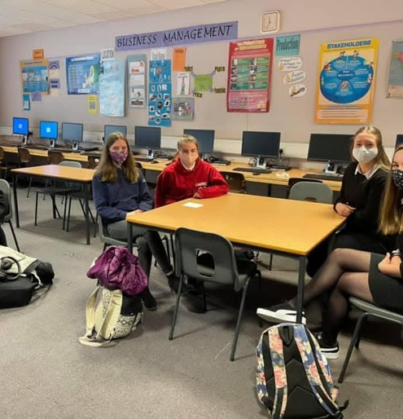
Happy Healthy Minds Seminar.
Through consultation Wanda choose 2 groups of young people
Wanda’s Famous 5 group and her Equalities and Diversity Steering Group
This was the first time ever that young people have been asked to present to the elected members – there was 112 people present.
We worked in partnership pulling together 2 different PowerPoints, these were a basis to stimulate key point’s for the groups to talk about.
These presentation’s were to highlight the some mental health challenges over the past 12 months and how the outstanding work within the Youthwork Virtual Classroom and physical youthwork classroom has helped.
A lot of the time and effort was put into preparing for this event
I have attached both powerpoint’s for you to read.

Slide 14
Feedback about the Seminar
A huge thank you to you all and please thank the young people for their efforts and enthusiasm feedback is so positive about the young people taking part and their honesty and commitment to making the Highland a happier, healthier place to live. It would be good to follow up with the young people on how we take their excellent work forward to the rest of Highlands young people. We will effect change 😊. Yvonne Ross - Caithness Pathfinder/Well Being
Hi Both, Thank you both so much for running your workshop and feeding back to plenary. The young people did so well by all accounts - an invite to education committee, I think. Please feedback my thanks to them. My desk is covered in post its with different comments made - I think across the workshops we will have a lot of information to make sense of. Please send on your Jam Board/notes you took. All delegates will be asked to share notes so that should give a full picture. Wanda, I hope you do not have a busy day ahead, it is quite exhausting hosting a workshop. What a great turn out. Many thanks, Gillian
I am so proud of our young people! The commitment shown by Wanda and Fraser, their strong partnership with the school, the work being done by Kaela and the focus group around PSE review, it is all so positive. Thank you everyone! Wanda, please pass this onto the young people! Thank you for all your support, Yvonne, very much appreciated. We pledge to continue to listen to the voice of our young people – such a basic and important part of making Highland the best it can be. Many thanks, Val Paterson Depute Head Teacher

Slide 15
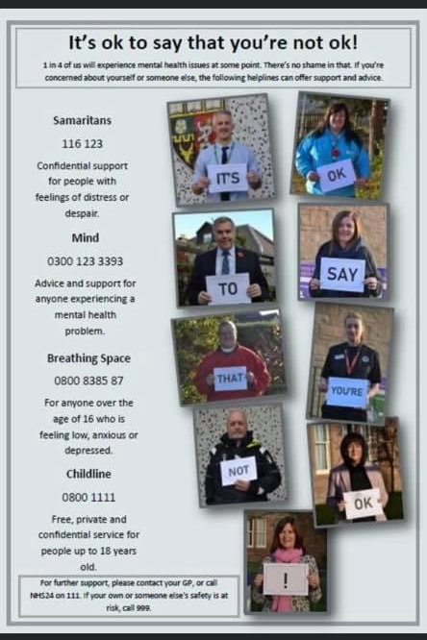
Tilly’s Mental Health Poster
Mental Health Awareness week 2021 10th-16th May
Thank you to Tilly for the time and effort put into creating this poster.
We would also like to express our gratitude to those involved, across our Black Isle community, for supporting and promoting the important message
“It’s ok to say that you’re not ok!” #mentalhealthawareness

Slide 16
Recognised Awards
Since October last year young people from Cromarty have taken part in 186 Recognised Awards
One young person who was disengaged from school started to work with Wanda and now he has completed 26 different courses.
I have supported him with some of these courses.
Often the courses are delivered on a 1-1 to basis, so the course can be broken down for the young people.
Sometimes the courses are delivered in a group setting.
Through out the courses Wanda will do a Q&A session on all topics covered, to check what we are learning
The majority of these course’s have been done through the CALA website, Young people are enjoying taking part in these course and are getting a lot out of taking part.
A number of these courses were paid for with Funding for the Middleton Trust.

Slide 17
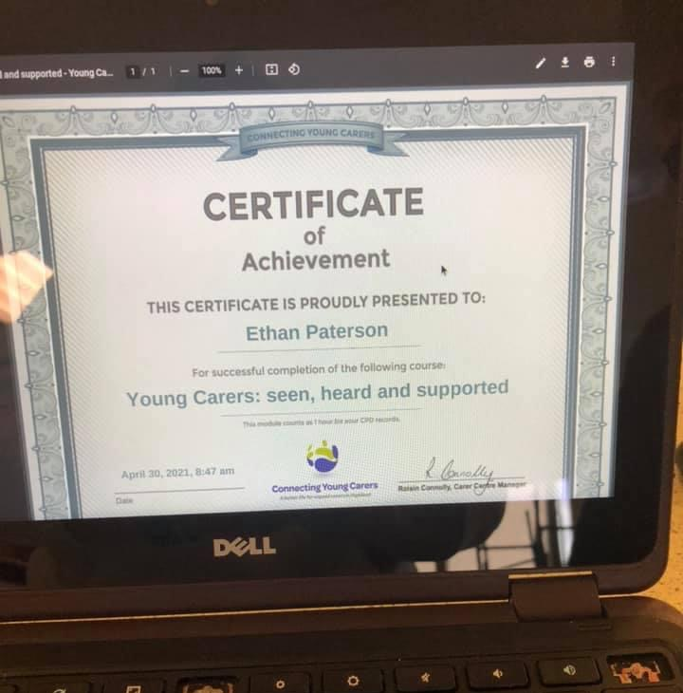
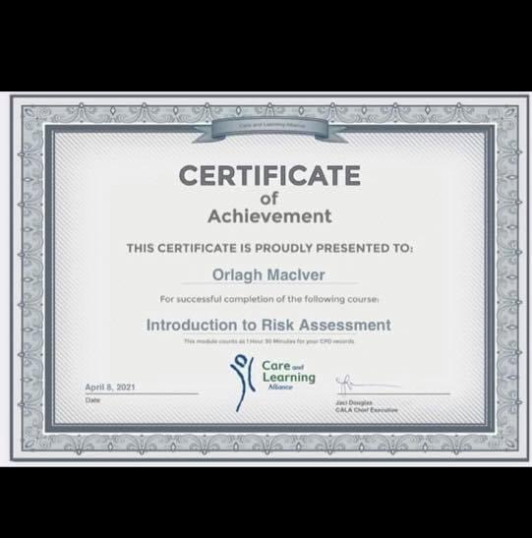

Slide 18
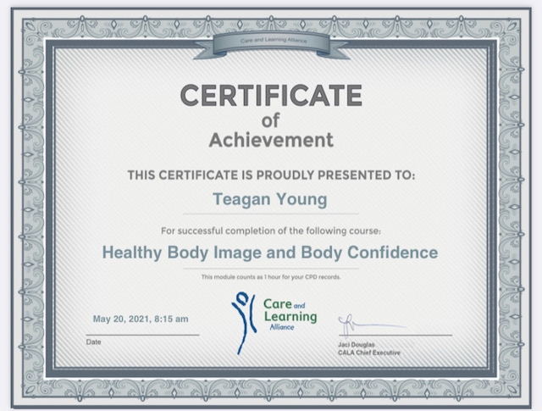
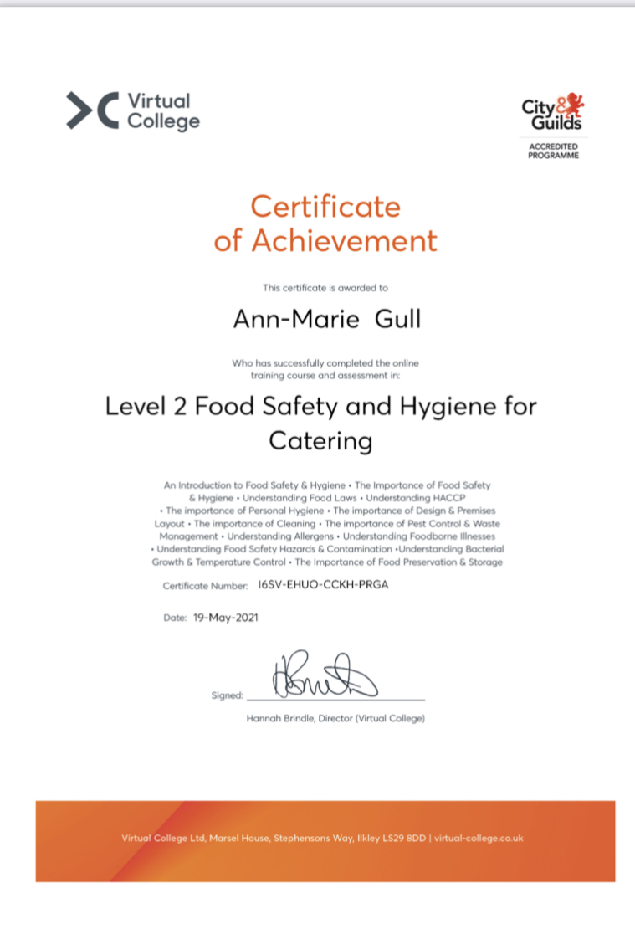
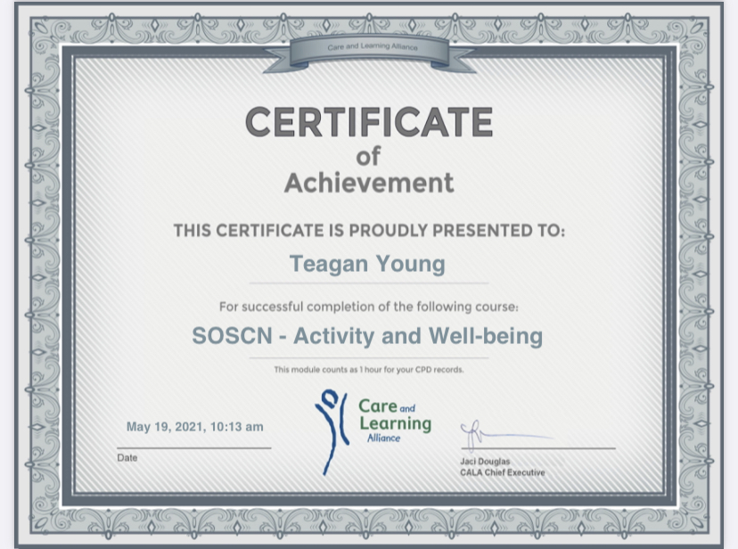

Slide 19
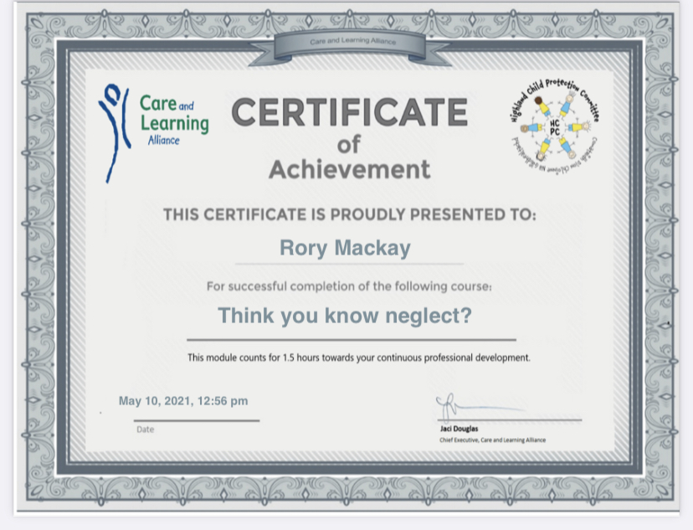
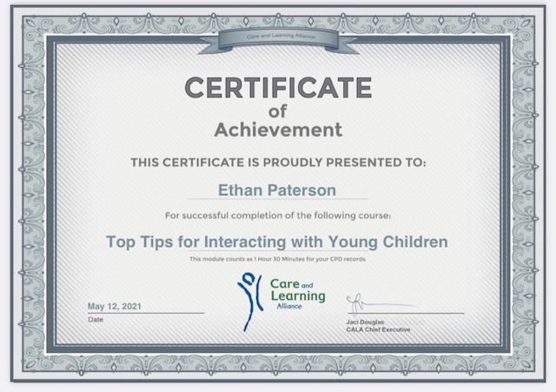

Slide 20
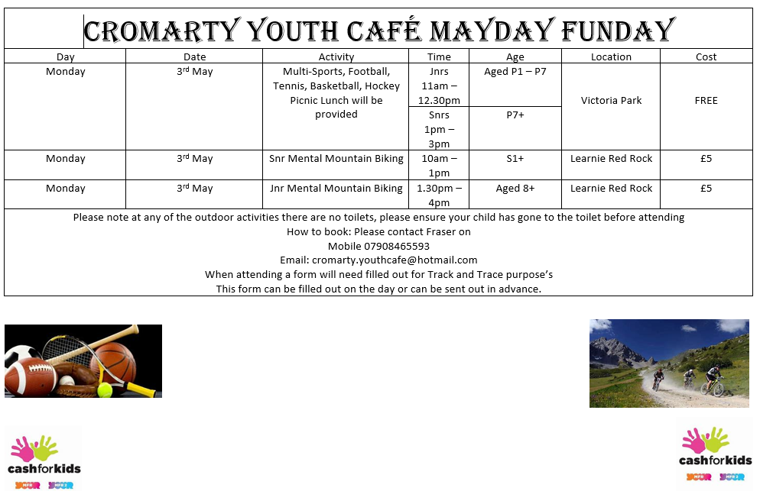
Mayday Funday
On the Bank Holiday in May we ran activities.

Slide 21
1-1’s
Each week there is number of 1-1’s offered to young people
These 1-1’s start of with an emotional check in,
At the 1-1’s we focus on health and wellbeing., we always ask young people how they are feeling so sessions can be tailored to their needs and wants
We talk about friendships and relationship’s.
Young people are really stressed and anxious right now due to the pressures of their assessments after a year of disrupted learning.
Some young people are requiring emotional check in or Walk and Talk’s at the weekend’s with Wanda.
One young person we work with is Transgender, they engage really well with Wanda.
Wanda has been working with a young person who recently lost a family member, Wanda did an application for an IPad and internet for 6 month, this supported the young person to be able to sign up for Universal credit – this young person is now working in a local business.

Slide 22
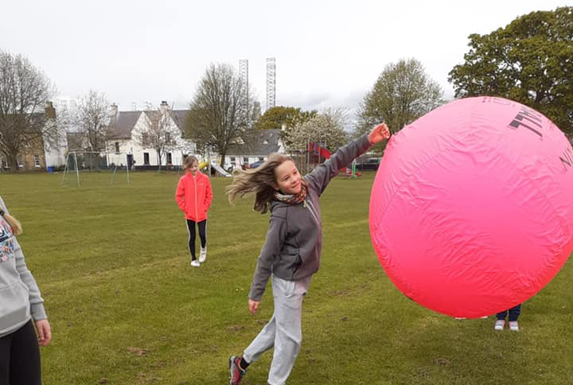
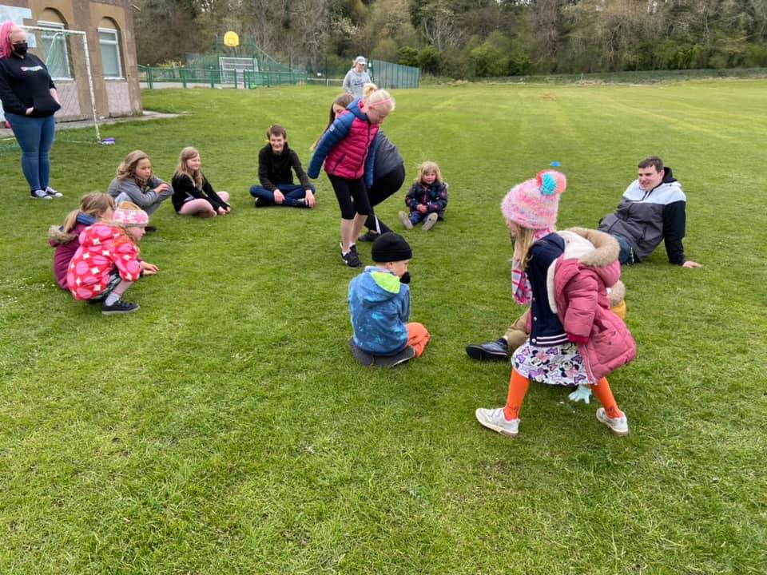
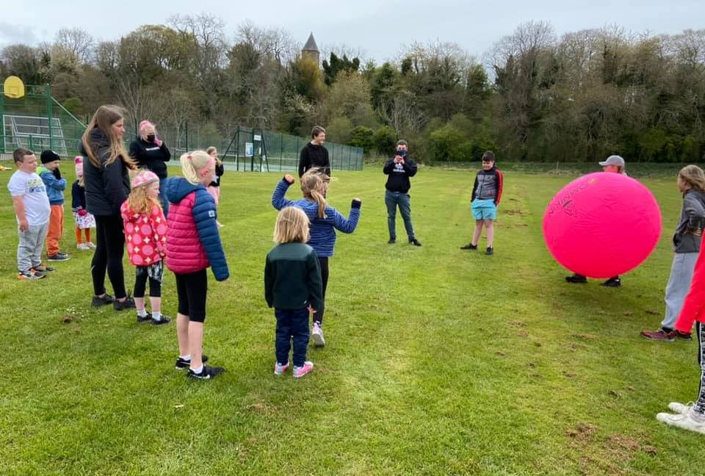

Slide 23
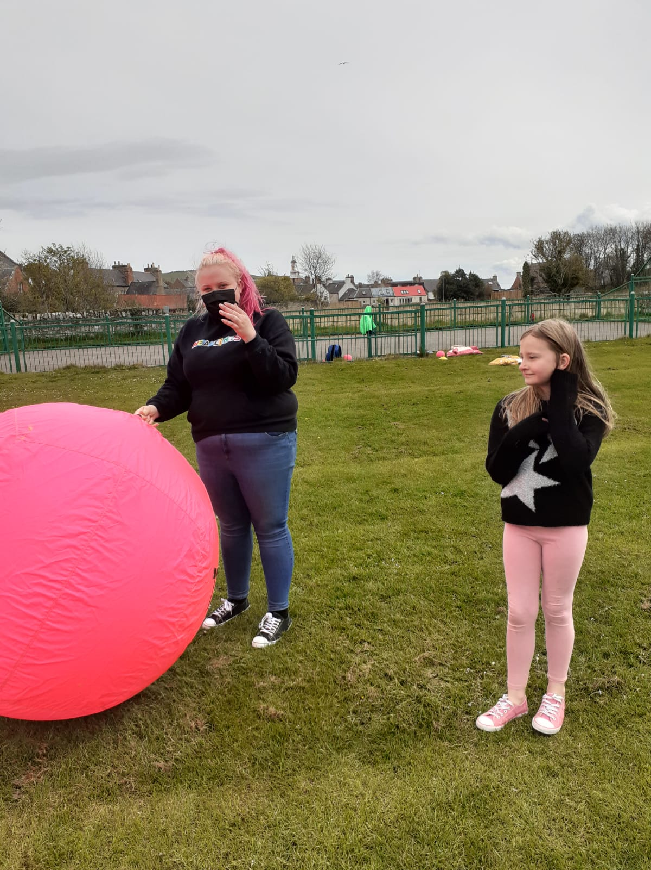
Paid Work Experience Placements
Another young person has completed their Paid Work Experience Placement.
This young person completed her Placement with us at The youth Café:
This was her feedback:
During this I learned about the diversity of children and their personalities, also each child's needs (such as allergies and health). This also helped my teamwork skills and how to operate as a team as I was working with some volunteers and staff. I also learned how to write a session report and planning sessions. This experience has taught me a lot but has also brought me closer to my goal of working with kids in a professional setting in the future.

Slide 24
Youth Employment
Over the last month Wanda has supported 2 young people into work
One young person is on the Kick Start programme with a local business in Cromarty.
A local resident let Wanda know about a work experience placement that may lead to a fulltime job, if Wanda could identify a young person, We had been working with a young person who fitted the bill perfectly. Wanda sign posted this young person to get in touch, as a result now the young person is in full time work

Slide 25
Planning for going Forward
Summer Programme is almost at draft.
Following on from a couple of confirmations I will start to work on, creating Risk Assessments, parental consent letters, Behaviour Management & Care & Welfare information
Creating all documents for track and trace purposes
Resilient Kids Planning with Cromarty Primary School
Junior Warden Scheme Planning

Slide 26
Junior Warden Scheme In partnership with Highland Council’s Tenants Participation Officer
Purpose of the Project
To give P7 Pupils an understanding of the work of the Community Wardens throughout Highland.
To help break down barriers between Highland Council and young people
To help make young people more aware of their environment/housing estate/community
To raise awareness of the work of other agencies / services in Highland
How does it work?
Working closely with Youth Development Officers and Head Teacher in Cromarty Primary School
Give a presentation to Pupils on the merits of the project
Send out welcome letter to all participants after the presentation

Slide 27
Junior Warden Scheme continued
Programme will include:
Launch Event – Presentation, due to COVID parents and guests will not be invited this year. The programme will run during term and holiday time. This will include some games to increase awareness of the role of community warden.
Walkabout / litter pick with Community Warden. Have a look at what you like/don’t like
Aniti social behaviour / Drugs & Alcohol awareness if appropriate
Awards session, final presentation ideas
Recycling awareness event
Role of the Housing Officer in your Community
Visit from the Cromarty Fire Services
Finalise awards – Dynamic Youth / Saltire / JWS
Finale event – presentations of awards – Youth presentation. Invite Parents and guests. This will take place at the beginning of the autumn term.
Visit from Police Scotland
First Aid delivered by the Local First Responders

Slide 28
When asking the young people at Youth Café about SHANARRI
Safe – Yes - because Fraser and John keep us safe
Healthy – Yes - because you give us healthy food
Active – Yes - because you play lots of games with us
Nurtured – Yes- because you always care and ensure we are safe
Achieving – Yes – sometimes when were learning a new game or skill
Respected – Yes - you always ask what we want to do and listen to us
Responsible – Yes - because the older young people take responsibility for the sessions.
Included – Yes - no young person Is left out all games are suited to the ability of the young people.

Slide 29
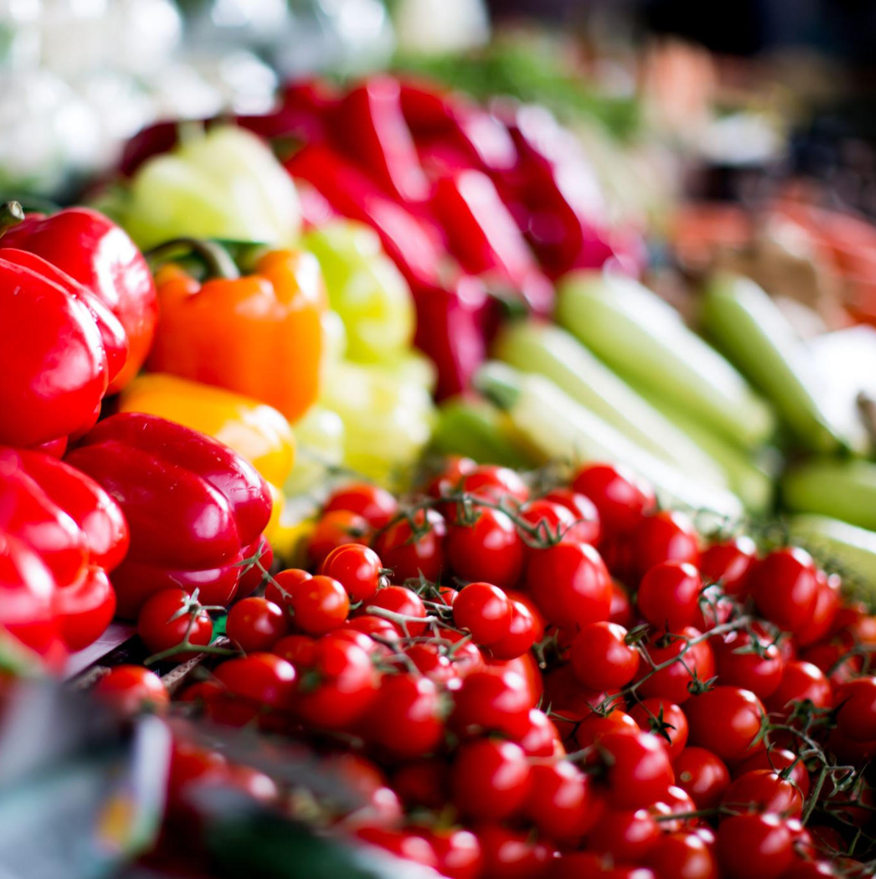
Jamie Oliver Cookery Class’s
The Tesco Community Cookery School was launched in 2019, in partnership with Jamie Oliver and FareShare, to help community groups by offering training and advice on how to prepare nutritionally balanced meals using surplus food donations to avoid food going to waste. This year, Tesco are focusing on training 300 community cooks (one of them is Wanda!) to teach people in their communities how to cook balanced meals and make healthier choices. The course will be delivered virtually on this website.
In total there is now 15 community cooks been trained by Wanda.
John & Myself along with a number of young people have been trained by Wanda

